Slide 1
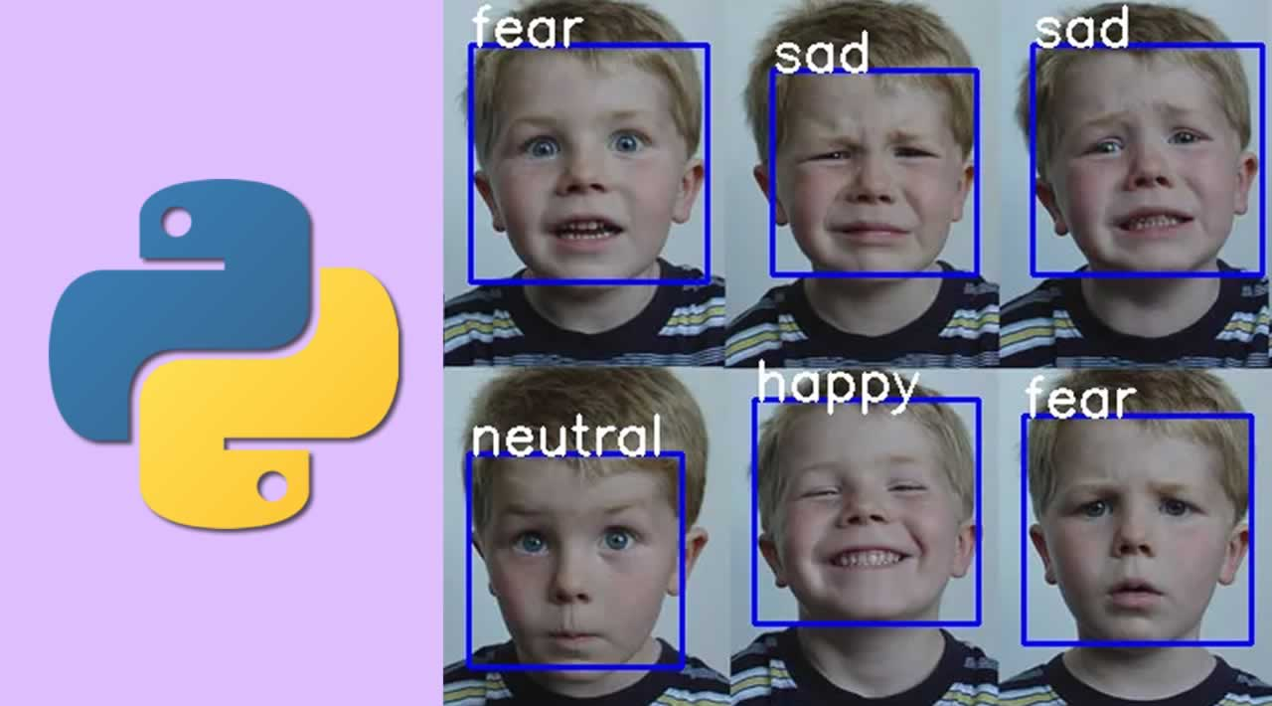
Emotion Detection Using
Deep Learning
Group No. 81
Group Members : Ankush Kashyap(181202), Prajwal Sharma(181220) ,
Kartik Gupta(181290)
Project Supervisor : Dr. Ruchi Verma

Slide 2
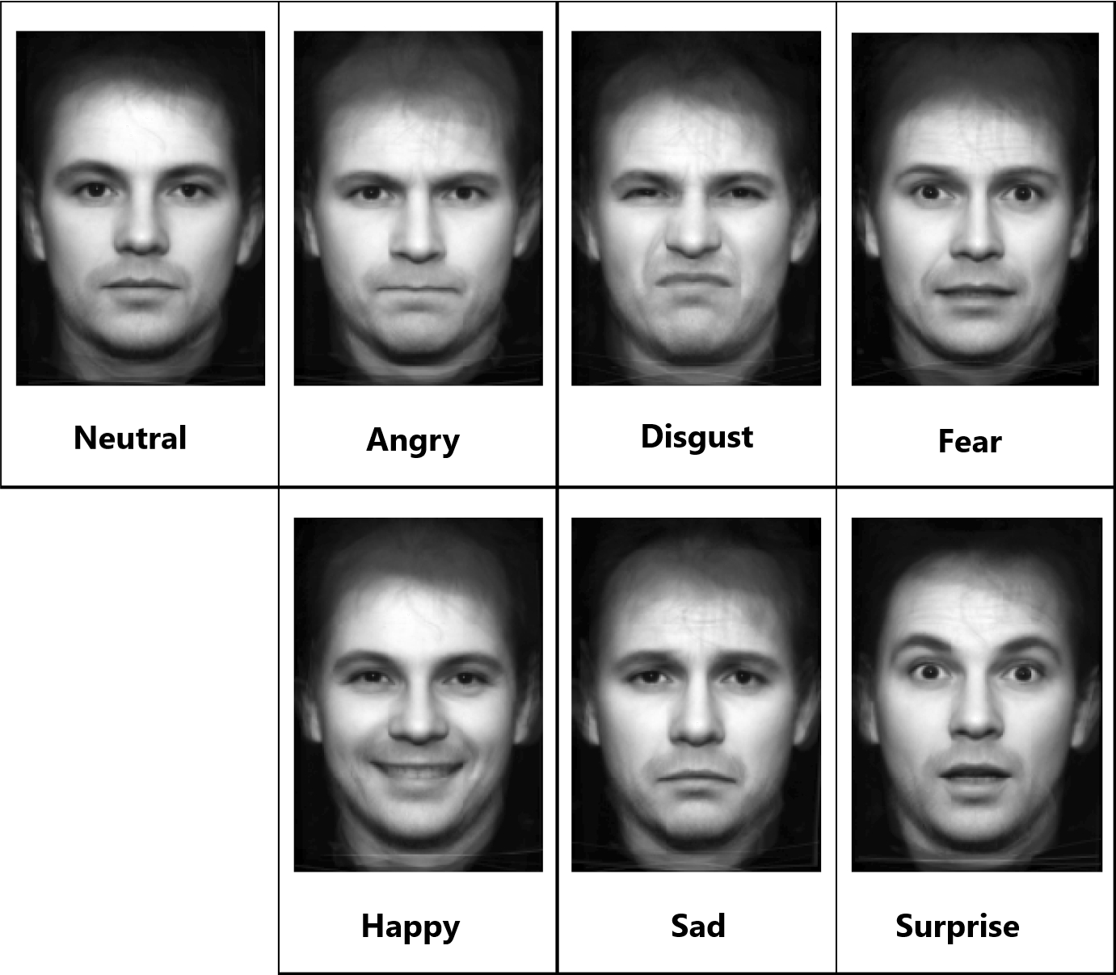
What is Human Emotion Detection??
Human Emotions are the non verbal clues which describe one’s mental state. There are 7 basic types of emotions- Happy, Sad, Surprise, Fear, Neutral, Disgust, Anger
Human Emotion detection is the method used to identify the Human Emotions by using various algorithms and techniques.

Slide 3

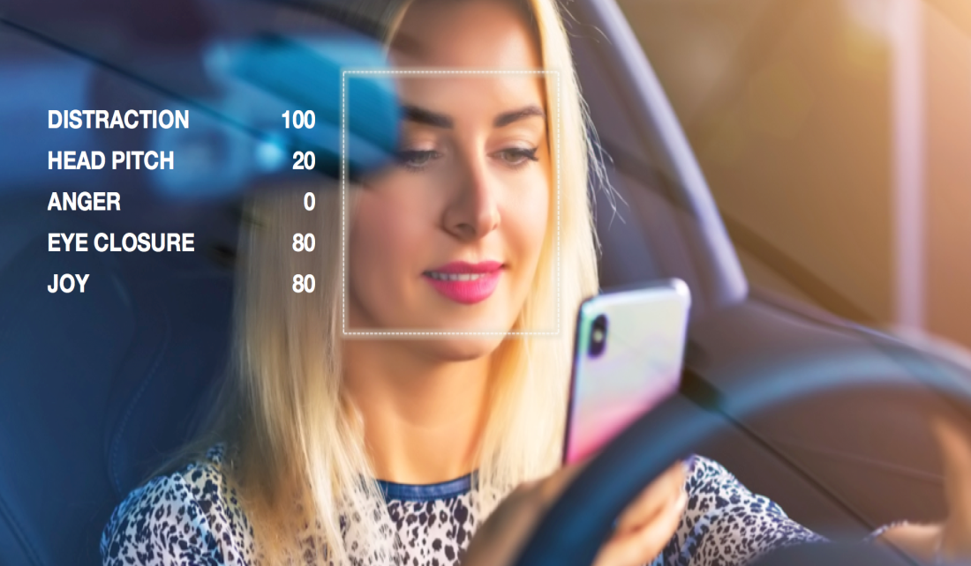

Applications of Emotion
Detection
AI cars
Lie Detectors
Robotics
Medical field

Slide 4
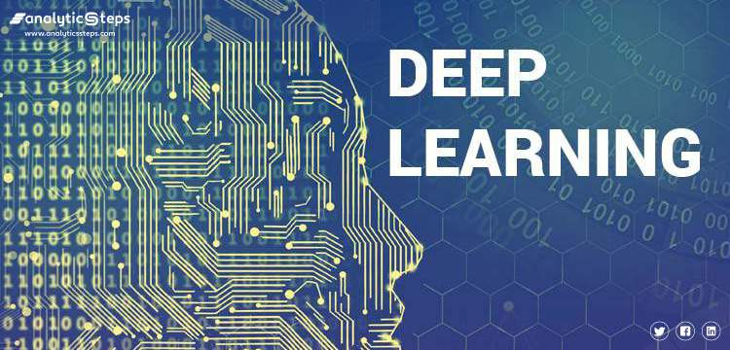
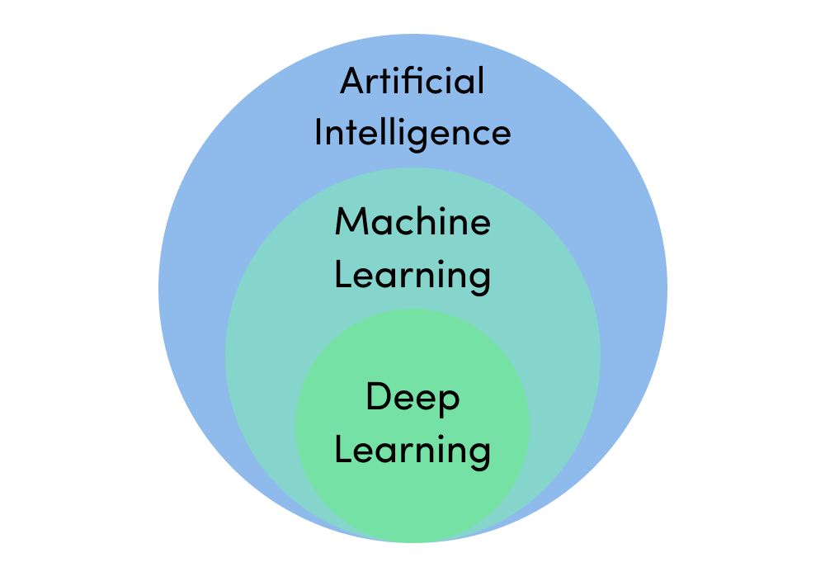
Deep Learning
Deep learning is a class of machine learning algorithms that uses multiple layers to progressively extract higher-level features from the raw input.
In deep learning, a computer model learns to perform classification tasks directly from images, text, or sound.
Deep Learning can even achieve an accuracy that is above human level performance manual tasks simple and easy.

Slide 5
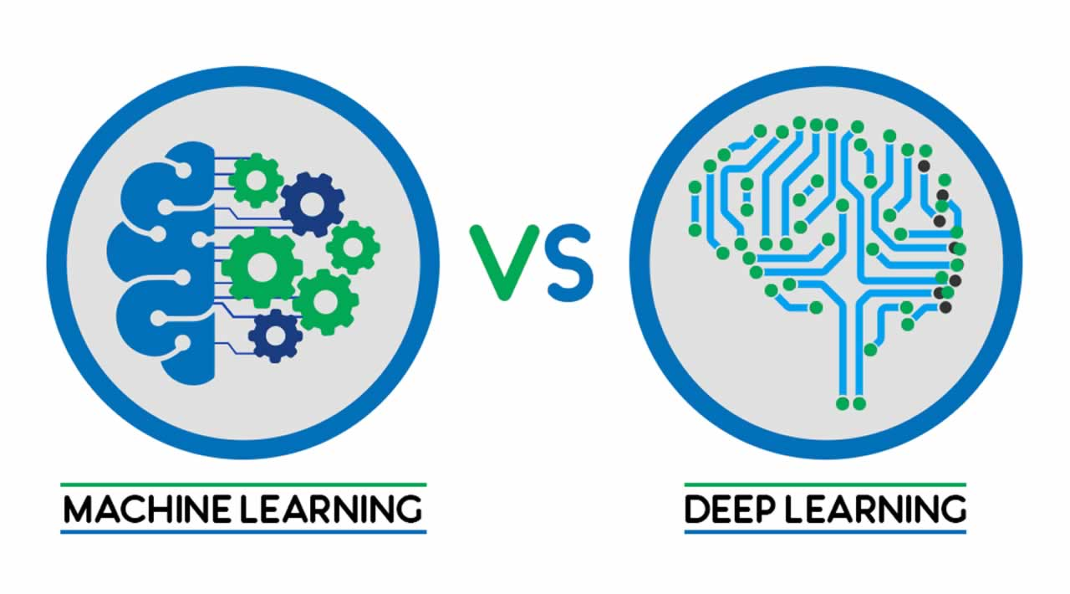
Deep Learning vs. Machine Learning
Deep learning is just a subset of machine learning. In fact, deep learning is machine learning and functions in a similar way. However, its capabilities are different.
FACTORS | DEEP LEARNING | MACHINE LEARNING
Data Requirement | Large Data | Lesser Data
Accuracy | High Accuracy | Lesser Accuracy
Training time | Longer time to train | Less time to train
Hardware dependencies | Requires GPU | Trains on CPU

Slide 6
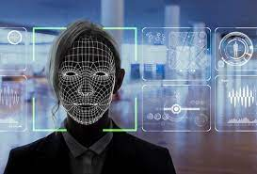
WHY DEEP LEARNING
FOR Emotion recognition?
Deep Learning Algorithm uses the neural networking which has the ability to learn and model the complex and non linear relationships.
Deep learning algorithm can be easily applied to the unsupervised and unstructured data.
Deep learning requires null manual efforts.

Slide 7
IMPLEMENTATION OF THE PROJECT
Libraries used
Pandas: pandas is a software library written for the Python programming language for data manipulation and analysis. In particular, it offers data structures and operations for manipulating numerical tables and time series.
Numpy: NumPy is a library for the Python programming language, adding support for large, multi-dimensional arrays and matrices, along with a large collection of high-level mathematical functions to operate on these arrays.
Matplotlib: It is a library used for data visualization during the various phases of out project.
Keras: Keras is a minimalist Python library for deep learning that can run on top of Theano or TensorFlow.

Slide 8
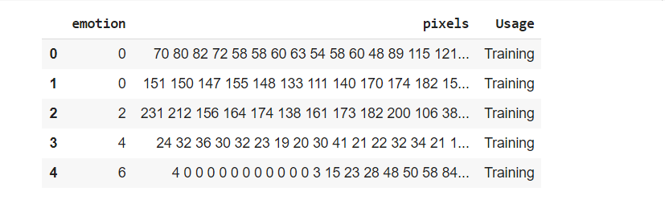
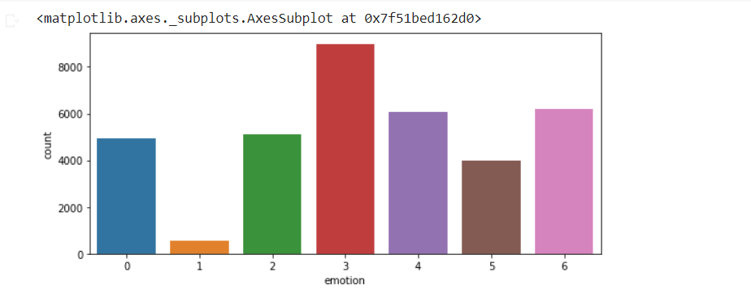
DATA SET
The dataset used in this project is FER2013 dataset which consists of 48x48 pixel grayscale images of human Faces and has 28,709 training rows and 3,589 public test rows and additional 3,589 rows for private test. The dataset has been divided into seven categories of each of the seven emotions.

Slide 9
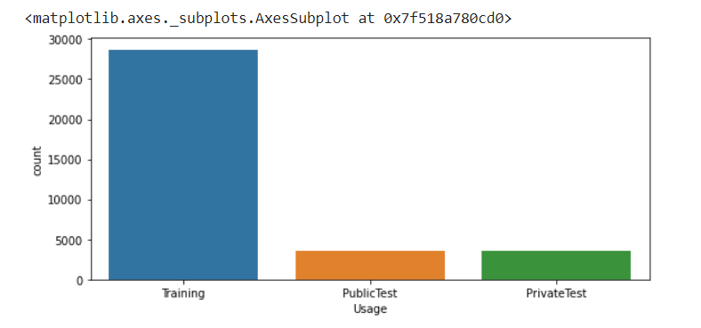
Training And Testing Datasets
Training dataset are the ones on which our model gets trained and the testing dataset is used for validation of the accuracy of model. FER2013 has already been labeled into training and testing sets in a suitable ratio of approximately 80:20 which is the ideal ratio.

Slide 10
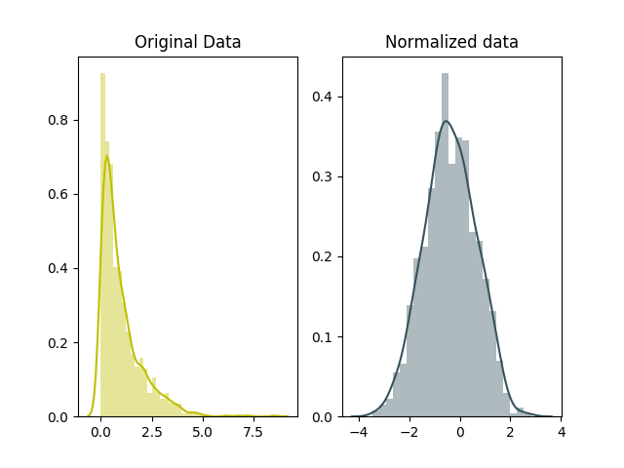
Normalization
Normalization is an approach which is applied during the preparation of data in order to change the values of numeric columns in a dataset to use a common scale when the features in the data have different ranges.

Slide 11
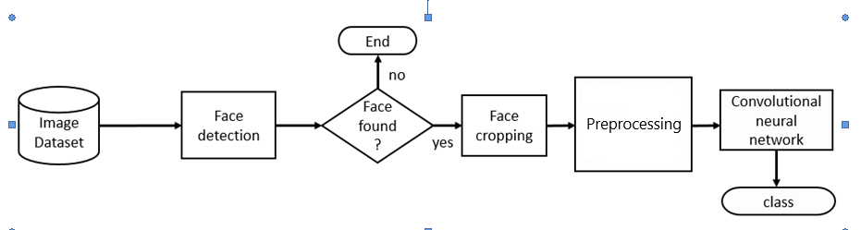
Designing the Convolutional network
A Convolutional Neural Network (CNN) is a Deep Learning algorithm which can take in an input image, assign importance (learnable weights and biases) to various aspects/objects in the image and be able to differentiate one from the other.

Slide 12
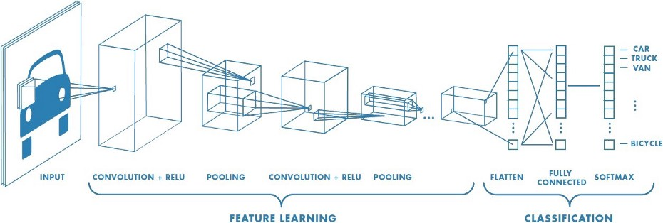
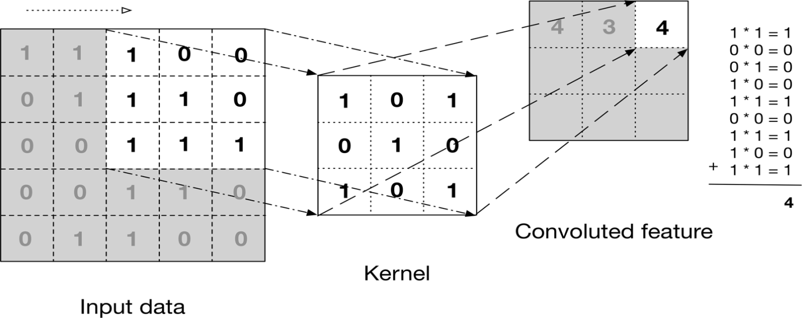
Fig.1 Feature extraction and classification using CNN network
Convolutional Layer: This layer is the first layer that is used to extract the various features from the input images. Mathematical convolution is done by sliding ‘kernel’ over the input image. The output of this layer is termed as Feature map or Convoluted feature which gives us information about the image such as the corners and edges

Slide 13
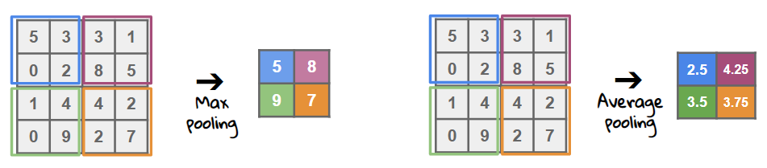
Pooling layer: The primary aim of this layer is to decrease the size of the convolved feature map to reduce the computational costs. In Max Pooling, the largest element is taken from feature map. Average Pooling calculates the average of the elements in a predefined sized Image section. The total sum of the elements in the predefined section is computed in Sum Pooling.

Slide 14
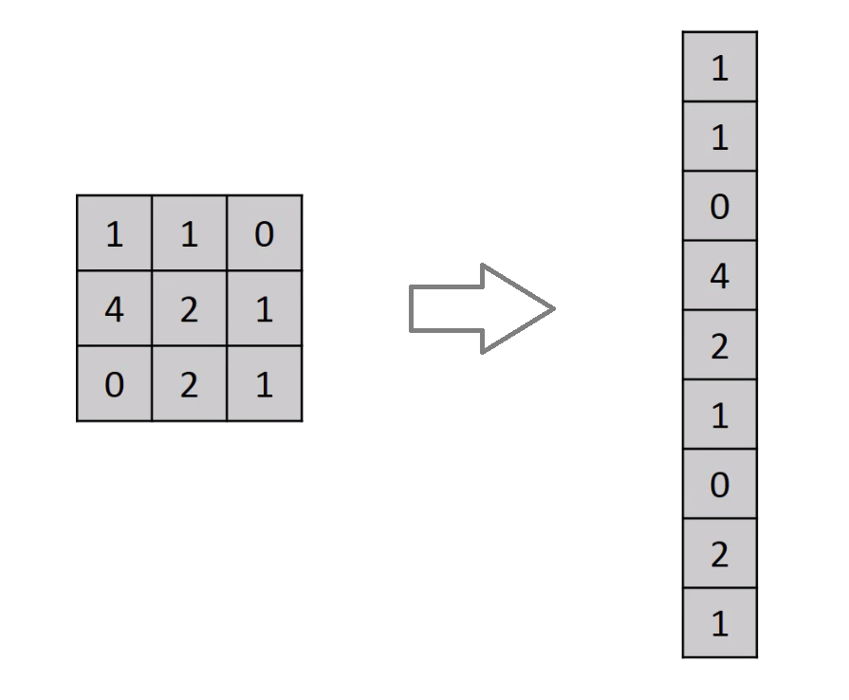
Flatten layer: Flattening is converting the data into a 1-dimensional array for inputting it to the next layer. We flatten the output of the convolutional layers to create a single long feature vector.

Slide 15
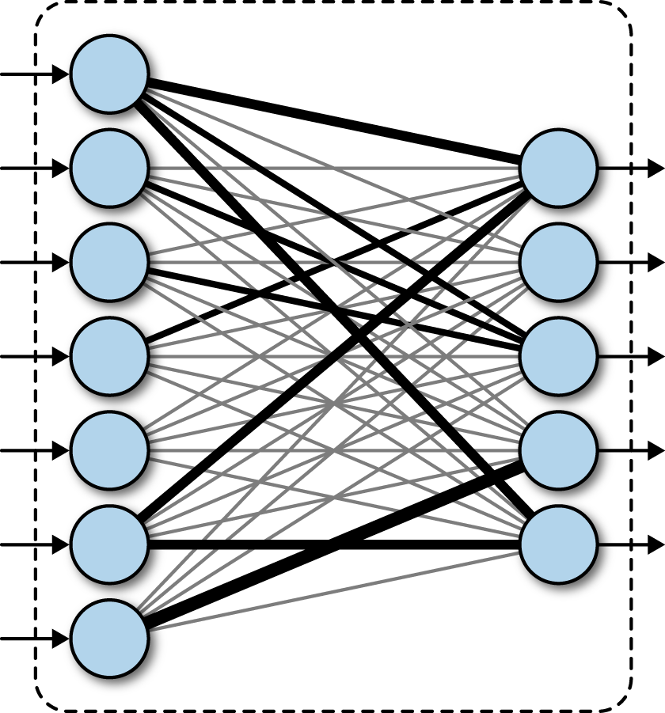
Fully connected layer: The Fully Connected (FC) layer consists of the weights and biases along with the neurons and is used to connect the neurons between two different layers. These layers are usually placed before the output layer and form the last few layers of a CNN Architecture.
Connecting the neurons
After flattening →

Slide 16
Activation Functions
ReLU (Rectified Linear Unit):
It is one of the most widely used activation functions that ensures non-linearity in our model by converting the negative numbers in the matrix to 0 and keeping the positive numbers as such.
Softmax Activation Function: It is an activation function that converts a vector of numbers into a vector of probabilities. Our model is designed to output 7 values(0 to 6) corresponding to different emotions, Softmax function normalizes the outputs and converts them from weighted sum values to probability values adding to one. Below is a diagram that specifies the working of the Softmax function.

Slide 17
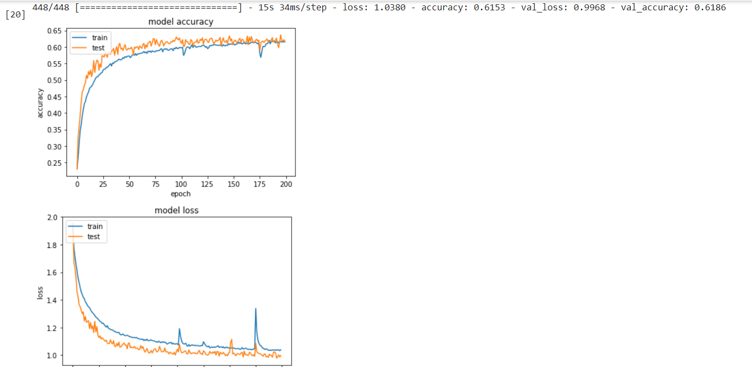
IMAGE AUGMENTATION
There is an optional step called Data/Image Augmentation while building a CNN model. It makes our model more robust and flexible. It modifies or augments the image in various ways such as inverting it, random rotations, shifts, whitening, zooming in or zooming out etc.

Slide 18
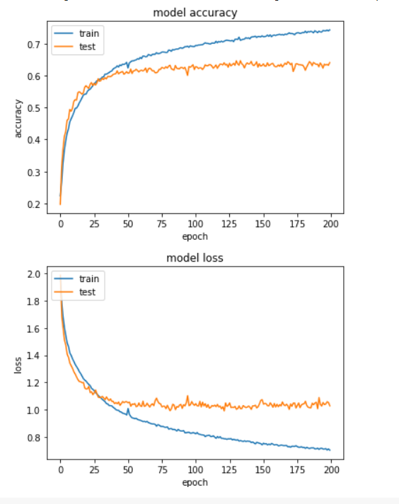
TRAINING THE MODEL
The model has been trained on 200 epochs and gives the following results:

Slide 19
Face detection using
Cascade Classifiers
We use the Haarcascade frontal face cascade classifier which has been trained to detect the face using similar methods used in feature detections in CNN.
The input picture is then converted to grayscale from RGB to make the processing easier.

